Slide 1
Presented by Hebe MSc Data Analytics, University of Warwick
Macro Sensitivity Analysis of UK & European Banking Stocks (2020–2025)
An Empirical Study of Interest Rate and FX Sensitivity Tools: Python (pandas, statsmodels, seaborn), Yahoo Finance API

Slide 2
Objective & Methodology

Slide 3
Object & Methodology
🎯 Objective
⚙️ Methodology
Quantify how UK and European bank equities respond to
changes in 10-year yield (^TNX)
changes in GBP/USD exchange rate
Identify which banks benefit most from rate hikes.
Data: Daily close prices (2020–2025, Yahoo Finance)
Variables:
Dependent: Daily stock returns
Independent: Δ10Y yield (^TNX), ΔGBP/USD
Model: OLS
Regression Tools: Python (pandas, statsmodels), Power BI for visualization
01

Slide 4
Normalized Stock Performance of Major UK & EU Banks (2020–2025)

Slide 5
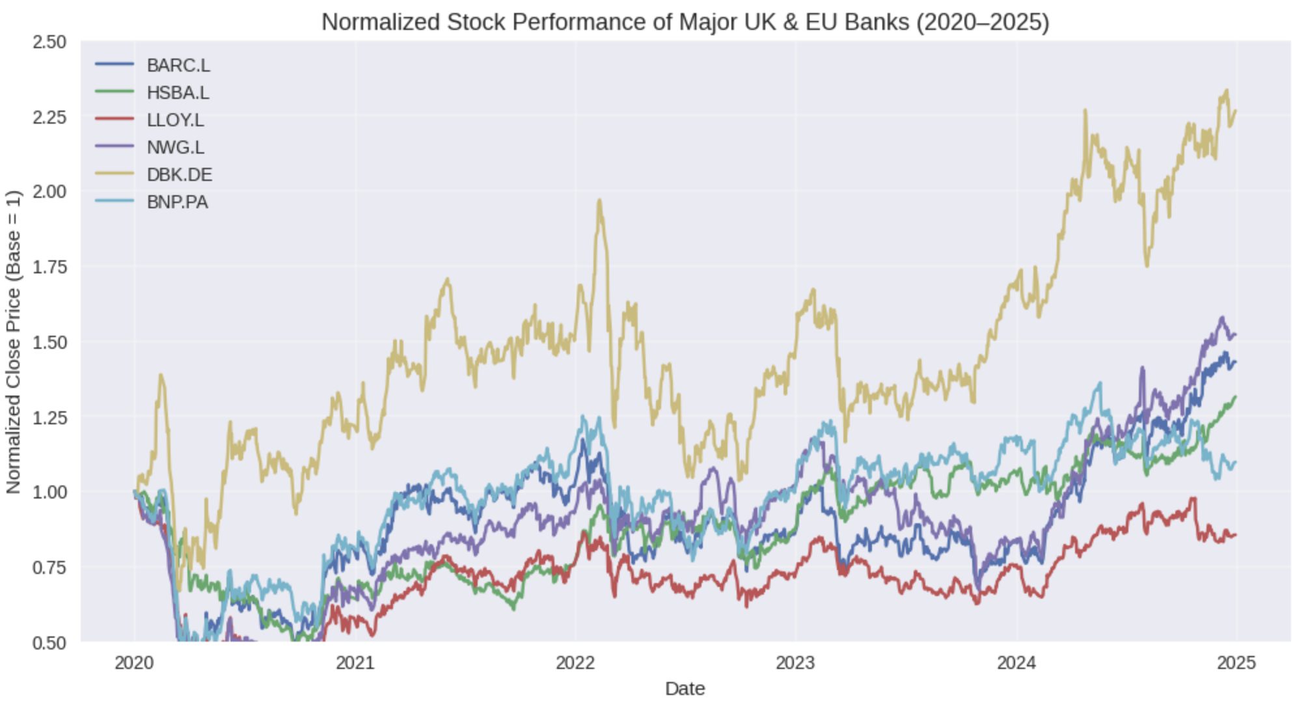
Normalized price chart
Key Insights
Barclays and Lloyds outperformed peers, doubling since 2020.
HSBC and European banks (BNP, DBK) remained relatively flat.
Divergence reflects different interest-rate exposures and business mixes.
02

Slide 6
Macro Beta Sensitivity
(UK & EU Banks)

Slide 7
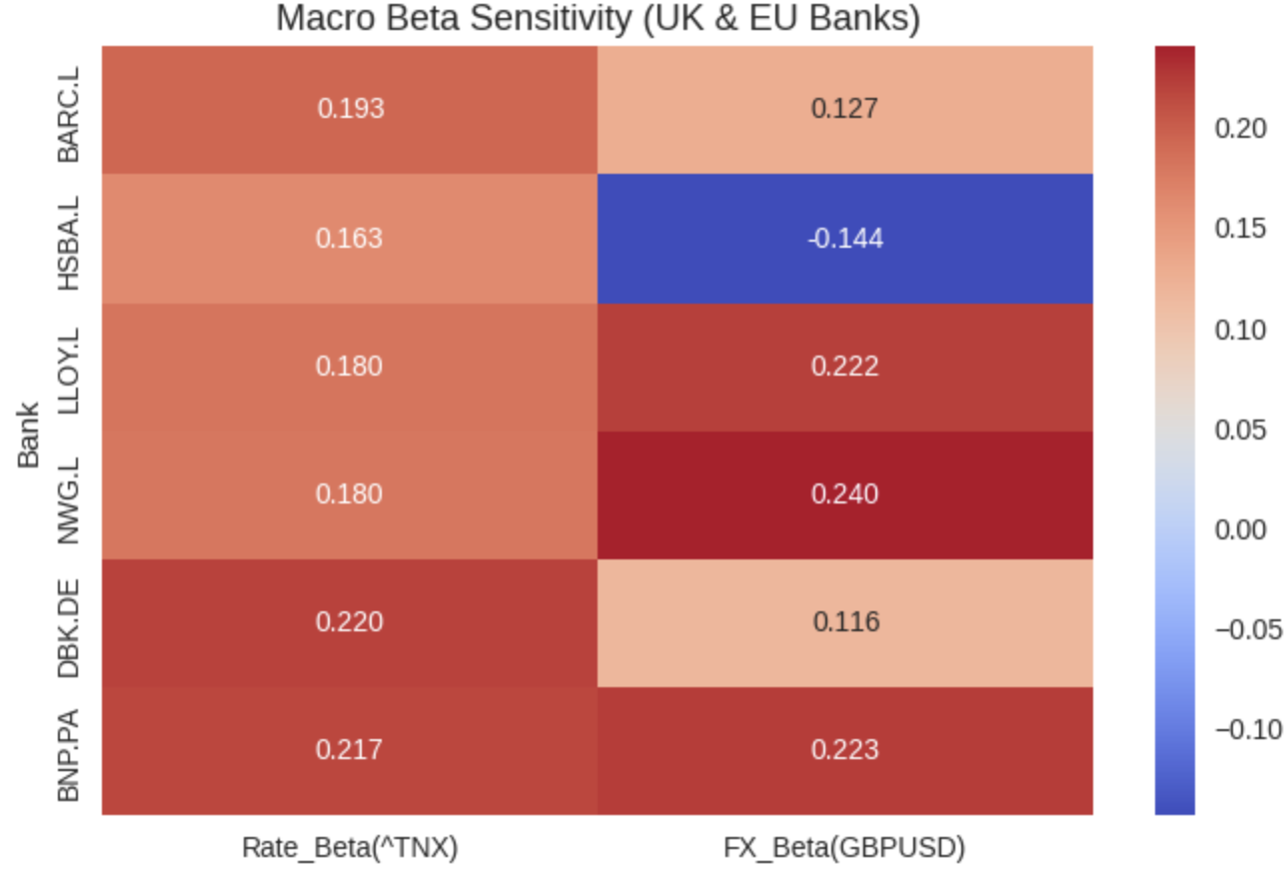
Heatmap（Macro Beta Sensitivity）
Key Takeaways
Barclays and Lloyds show the strongest positive β to interest rates, indicating they have benefited the most from BoE rate hikes.
HSBC’s negative FX beta shows its exposure to USD revenues.
Continental banks (BNP, DBK) also exhibit rate-driven movement, though less pronounced.
Bank | Rate Beta (^TNX) | FX Beta (GBP/USD)
Barclays | 0.19 | +0.13
Lloyds | 0.18 | +0.22
HSBC | 0.16 | -0.14
BNP / DBK | 0.21 | +0.12~0.22
03

Slide 8
Regression Visualization
&
Conclusion

Slide 9
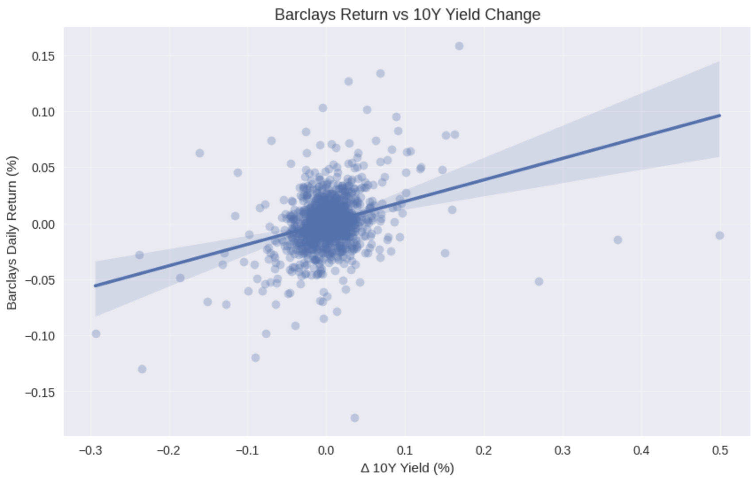
Barclays Return vs 10Y Yield Change
Key Insights
A clear positive linear relationship is observed — confirming that Barclays’ daily returns rise with higher yields. This supports the thesis that UK domestic banks are highly rate-sensitive.
04

Slide 10
Summary
&
Next Steps

Slide 11
Summary / Next Steps
Summary
Next Steps
UK banks (esp. Barclays, Lloyds) exhibit strong positive rate betas.
HSBC shows unique negative FX beta due to global exposure.
Results align with macro fundamentals (2022–2024 rate hikes).
Add CPI inflation rate analysis to examine the impact of inflation on bank net interest margins.
Perform a dynamic beta analysis (rolling regression) with a 3–6 month horizon.
Add European 10-year yield comparison (Bund vs. Gilt spread).
05

Slide 12
Component
State Management
Router
END
Presented by Hebe MSc Data Analytics, University of Warwick

